Slide 1
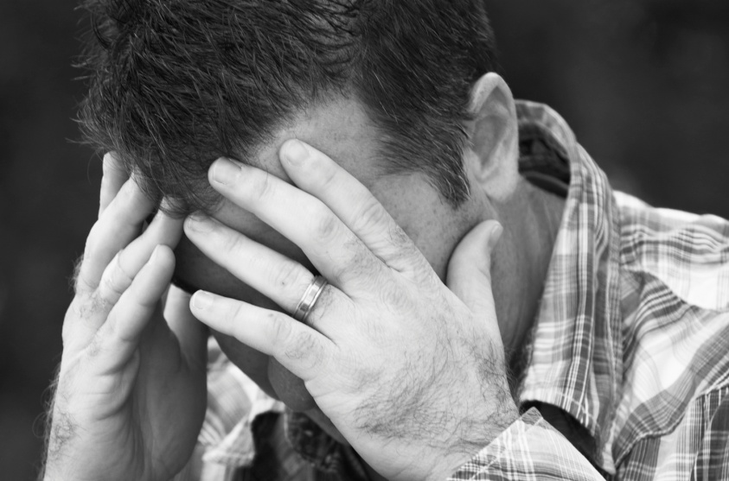
When Tragedy Strikes
Psalm 46

Slide 2
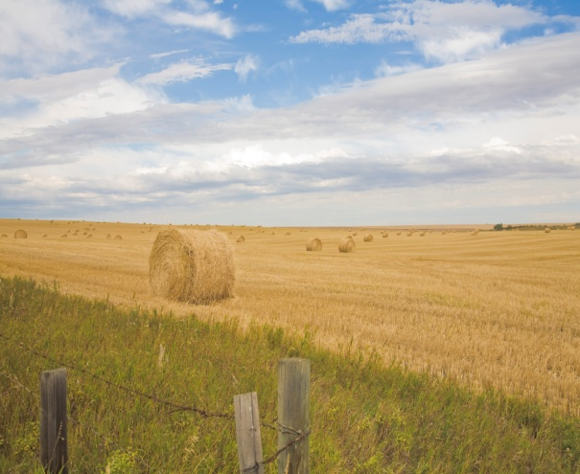
When Tragedy Strikes
Genesis 3:17-19
“Because you listened to your wife and ate fruit from the tree about which I commanded you, ‘You must not eat from it,’ “Cursed is the ground because of you; through painful toil you will eat food from it all the days of your life. ¹⁸ It will produce thorns and thistles for you, and you will eat the plants of the field. ¹⁹ By the sweat of your brow you will eat your food until you return to the ground, since from it you were taken; for dust you are and to dust you will return.”

Slide 3
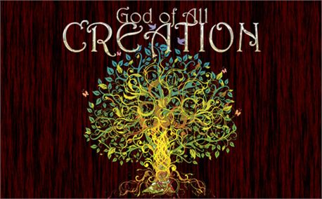
When Tragedy Strikes
Romans 8:19-22
¹⁹ For the creation waits in eager expectation for the children of God to be revealed. ²⁰ For the creation was subjected to frustration, not by its own choice, but by the will of the one who subjected it, in hope ²¹ that the creation itself will be liberated from its bondage to decay and brought into the freedom and glory of the children of God. ²² We know that the whole creation has been groaning as in the pains of childbirth right up to the present time.

Slide 4

When Tragedy Strikes
Psalm 46:1
God is our refuge and strength, an ever-present help in trouble.
² Therefore we will not fear, though the earth give way and the mountains fall into the heart of the sea, ³ though its waters roar and foam and the mountains quake with their surging.

Slide 5
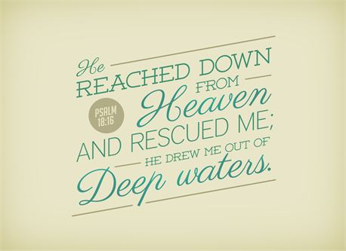
When Tragedy Strikes
Psalm 46:6-7
⁶ Nations are in uproar, kingdoms fall; he lifts his voice, the earth melts. ⁷ The Lord Almighty is with us; the God of Jacob is our fortress.
2 Timothy 4:18
The Lord will rescue me from every evil attack and will bring me safely to his heavenly kingdom. To him be glory for ever and ever.

Slide 6
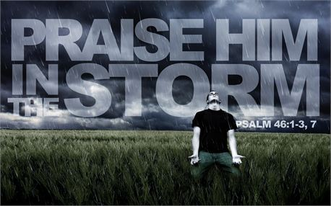
When Tragedy Strikes
Psalm 46:10
He says, “Be still, and know that I am God; I will be exalted among the nations, I will be exalted in the earth.” ¹¹ The Lord Almighty is with us; the God of Jacob is our fortress.
Job 1:21
“The Lord gave and the Lord has taken away; may the name of the Lord be praised.”

Slide 7

When Tragedy Strikes
Romans 5:3-5
³…we also glory in our sufferings, because we know that suffering produces perseverance; ⁴ perseverance, character; and character, hope. ⁵ And hope does not put us to shame, because God’s love has been poured out into our hearts through the Holy Spirit, who has been given to us.
Romans 8:18
I consider that our present sufferings are not worth comparing with the glory that will be revealed in us.

Slide 8
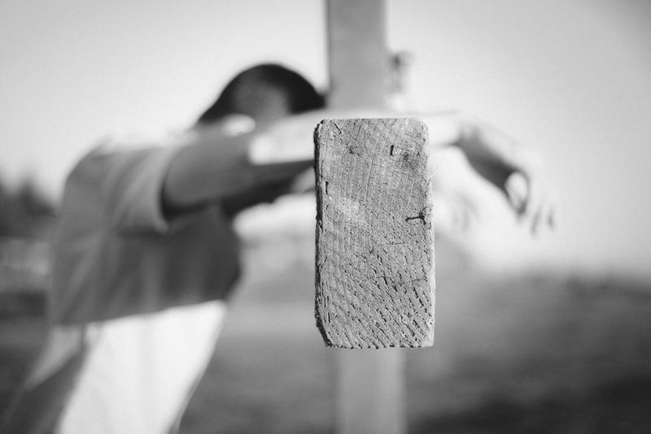
When Tragedy Strikes
2 Corinthians 14:16-18
¹⁶ Therefore we do not lose heart. Though outwardly we are wasting away, yet inwardly we are being renewed day by day. ¹⁷ For our light and momentary troubles are achieving for us an eternal glory that far outweighs them all. ¹⁸ So we fix our eyes not on what is seen, but on what is unseen, since what is seen is temporary, but what is unseen is eternal.

Slide 9
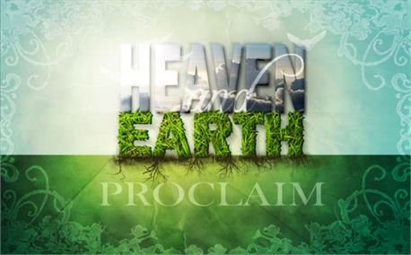
When Tragedy Strikes
Isaiah 65:17-19
“See, I will create new heavens and a new earth. The former things will not be remembered, nor will they come to mind. ¹⁸ But be glad and rejoice forever in what I will create, for I will create Jerusalem to be a delight and its people a joy. ¹⁹ I will rejoice over Jerusalem and take delight in my people; the sound of weeping and of crying will be heard in it no more.”

