Slide 1
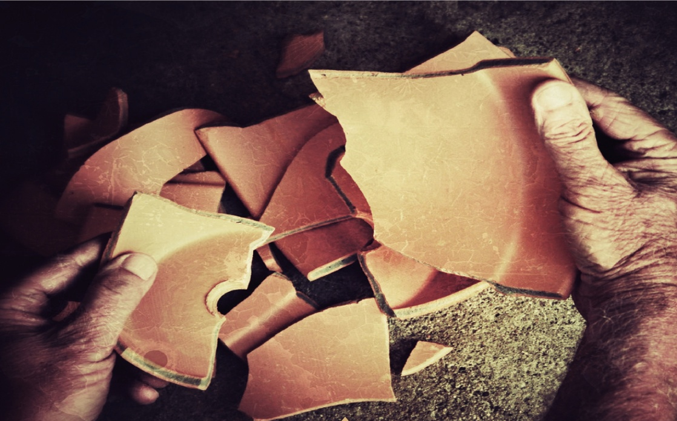
Jesus Reconciles our Broken World
Series: He created everything
Colossians 1:18-22

Slide 2
Jesus Reconciles our Broken World
Colossians 1:19-22
¹⁹ For God was pleased to have all his fullness dwell in him, ²⁰ and through him to reconcile to himself all things, whether things on earth or things in heaven, by making peace through his blood, shed on the cross. ²¹ Once you were alienated from God and were enemies in your minds because of your evil behavior. ²² But now he has reconciled you by Christ’s physical body through death to present you holy in his sight, without blemish and free from accusation…

Slide 3
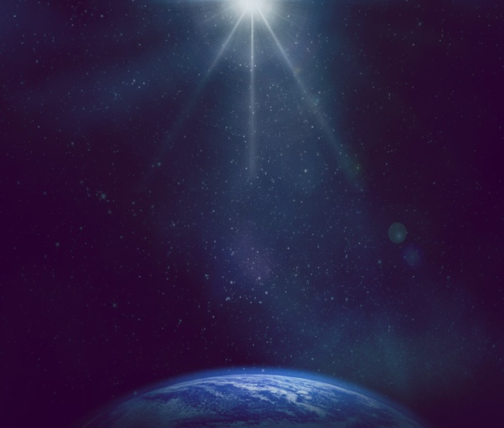
Jesus Reconciles our Broken World
Romans 8:20-22
²⁰ For the creation was subjected to frustration, not by its own choice, but by the will of the one who subjected it, in hope ²¹ that the creation itself will be liberated from its bondage to decay and brought into the freedom and glory of the children of God. ²² We know that the whole creation has been groaning as in the pains of childbirth right up to the present time.

Slide 4
Jesus Reconciles our Broken World
Isaiah 11:6-9
⁶ The wolf will live with the lamb, the leopard will lie down with the goat, the calf and the lion and the yearling together; and a little child will lead them. ⁷ The cow will feed with the bear, their young will lie down together, and the lion will eat straw like the ox. ⁸ The infant will play near the cobra’s den, and the young child will put its hand into the viper’s nest. ⁹ They will neither harm nor destroy on all my holy mountain, for the earth will be filled with the knowledge of the Lord as the waters cover the sea.

Slide 5
Jesus Reconciles our Broken World
Revelation 21:3-4
³“Look! God’s dwelling place is now among the people, and he will dwell with them. They will be his people, and God himself will be with them and be their God. ⁴ ‘He will wipe every tear from their eyes. There will be no more death’ or mourning or crying or pain, for the old order of things has passed away.”

Slide 6
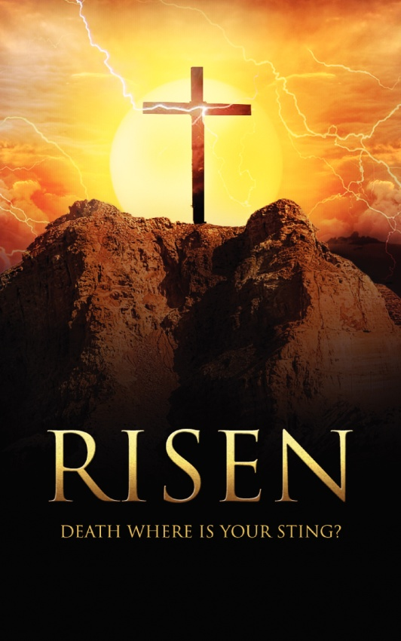
Jesus Reconciles our Broken World
Reconciled by Christ’s Resurrection
Colossians 1:18
And he is the head of the body, the church; he is the beginning and the firstborn from among the dead, so that in everything he might have the supremacy.

Slide 7
Jesus Reconciles our Broken World
Reconciled by Christ’s Incarnation
Colossians 1:19
For God was pleased to have all his fullness dwell in him.

Slide 8
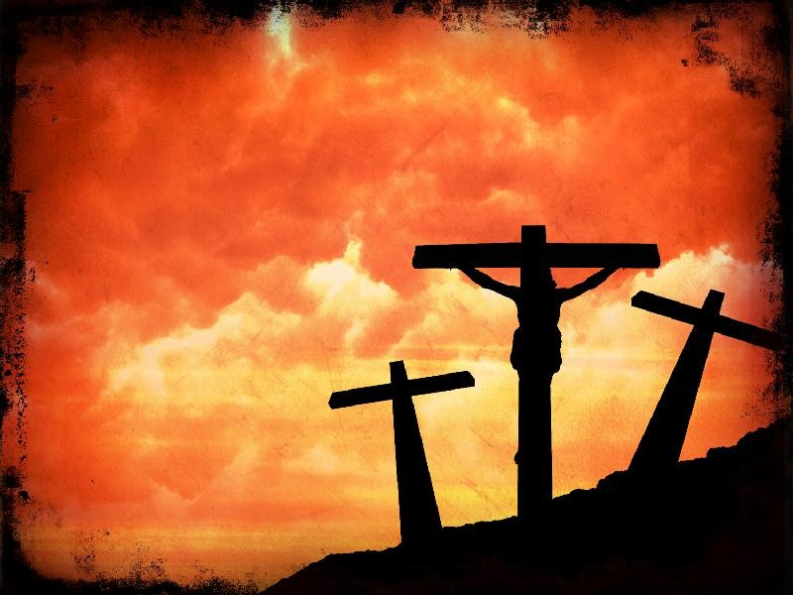
Jesus Reconciles our Broken World
Reconciled by Christ’s Crucifixion
Colossians 1:19-20
¹⁹ For God was pleased to have all his fullness dwell in him, ²⁰ and through him to reconcile to himself all things, whether things on earth or things in heaven, by making peace through his blood, shed on the cross.
Colossians 1:21
Once you were alienated from God and were enemies in your minds because of your evil behavior.

Slide 9
Jesus Reconciles our Broken World
Because of Jesus:
You are forgiven
Colossians 1:21-22
Once you were alienated from God and were enemies in your minds because of your evil behavior. ²² But now he has reconciled you by Christ’s physical body through death to present you holy in his sight, without blemish and free from accusation…
You have resurrection power
You join a new community
You become part of God’s work

